Slide 1
Game Analysis project
Prepared by
: Nabin Kattel

Slide 2
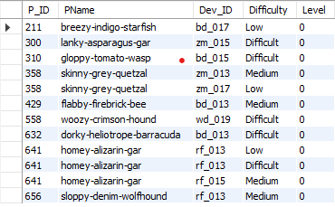
Q1) Extract P_ID,Dev_ID,PName and Difficulty_level of all players at level 0
SQL code :
SELECT
pd.P_ID, pd.PName, ld.Dev_ID, ld.Difficulty, ld.Level
FROM
level_details2 ld
INNER JOIN
player_details pd ON pd.P_ID = ld.P_ID
WHERE
ld.Level = 0;

Slide 3

Find Level1_code wise Avg_Kill_Count where lives_earned is 2 and atleast 3 stages are crossed
SELECT
pd.L1_Code, AVG(ld.Kill_Count) AS avg_kill
FROM OUTPUT:
level_details2 ld
INNER JOIN
player_details pd ON pd.P_ID = ld.P_ID
WHERE
ld.Lives_Earned = 2
AND ld.Stages_crossed >= 3
GROUP BY pd.L1_Code

Slide 4
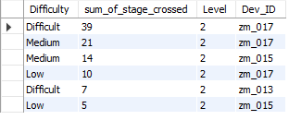
Find the total number of stages crossed at each diffuculty level where for Level2 with players use zm_series devices. Arrange the result in decsreasing order of total number of stages crossed.
SELECT
ld.Difficulty,
SUM(ld.Stages_crossed) AS sum_of_stage_crossed,
ld.Level,
ld.Dev_ID
FROM
level_details2 ld
INNER JOIN
player_details pd ON pd.P_ID = ld.P_ID
WHERE
ld.Level = 2 AND ld.Dev_ID LIKE 'zm%'
GROUP BY ld.Difficulty , ld.Level , ld.Dev_ID
ORDER BY sum_of_stage_crossed DESC

Slide 5
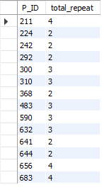
Extract P_ID and the total number of unique dates for those players who have played games on multiple days
SELECT
ld.P_ID,
COUNT(DISTINCT DATE(ld.start_datetime)) AS total_repeat
FROM
level_details2 ld
GROUP BY ld.P_ID
HAVING COUNT(DISTINCT DATE(ld.start_datetime)) > 1

Slide 6
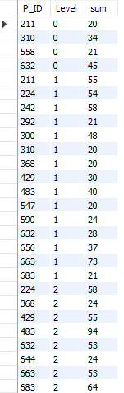
Find P_ID and level wise sum of kill_counts where kill_count is greater than avg kill count for the Medium difficulty.
SELECT
ld.P_ID, ld.Level, SUM(ld.Kill_Count) AS sum
FROM
level_details2 ld
WHERE
ld.Kill_Count > (SELECT
AVG(Kill_Count)
FROM
level_details2
WHERE
Difficulty = 'Medium')
GROUP BY ld.level , ld.P_ID
ORDER BY ld.level

Slide 7
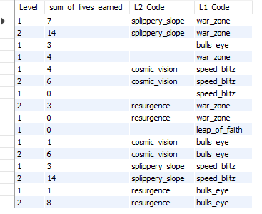
Find Level and its corresponding Level code wise sum of lives earned excluding level 0. Arrange in asecending order of level.
SELECT
ld.Level,
SUM(ld.Lives_Earned) AS sum_of_lives_earned,
pd.L2_Code,
pd.L1_Code
FROM
level_details2 ld
INNER JOIN
player_details pd ON pd.P_ID = ld.P_ID
where ld.Level >0
GROUP BY ld.Level , pd.L2_Code , pd.L1_Code

Slide 8
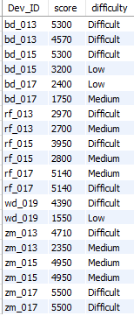
Find Top 3 score based on each dev_id and Rank them in increasing order using Row_Number. Display difficulty as well.
SELECT Dev_ID, score, difficulty
FROM (
SELECT ld.Dev_ID, ld.score, ld.difficulty,
ROW_NUMBER() OVER (PARTITION BY ld.Dev_ID ORDER BY ld.score DESC) AS 'rank'
FROM level_details2 ld
) AS ranked_scores
WHERE ranked_scores.rank < 3
ORDER BY Dev_ID, ranked_scores.rank;

Slide 9
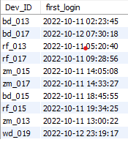
Find first_login datetime for each device id
SELECT Dev_ID, MIN(start_datetime) AS first_login
FROM level_details2
GROUP BY Dev_ID;

Slide 10
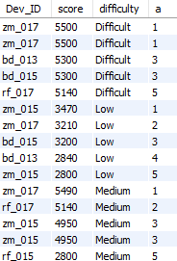
Find Top 5 score based on each difficulty level and Rank them in increasing order using Rank. Display dev_id as well.
SELECT Dev_ID, score, difficulty, a
FROM (
SELECT Dev_ID, score, difficulty,
RANK() OVER (PARTITION BY difficulty ORDER BY score DESC) AS a
FROM level_details2
) AS ranked_scores
WHERE a <= 5
ORDER BY difficulty, a;

Slide 11
Find the device ID that is first logged in(based on start_datetime)for each player(p_id). Output should contain player id, device id and first login datetime.
SELECT ld.P_ID, ld.Dev_ID, ld.start_datetime AS first_login_datetime
FROM level_details2 ld
JOIN (
SELECT P_ID, MIN(start_datetime) AS first_login_time
FROM level_details2 ld
GROUP BY P_ID
) AS first_login ON ld.P_ID = first_login.P_ID AND ld.start_datetime = first_login.first_login_time;

Slide 12
For each player and date, how many kill_count played so far by the player. That is, the total number of games played by the player until that date.
a) window function
b) without window function
-- with window function
SELECT P_ID, DATE(start_datetime) AS date,
SUM(kill_count) OVER (PARTITION BY P_ID ORDER BY DATE(start_datetime)) AS total_kill_count_so_far
FROM level_details2;
-- without window function
SELECT ld1.P_ID, DATE(ld1.start_datetime) AS date,
SUM(ld2.kill_count) AS total_kill_count_so_far
FROM level_details2 ld1
JOIN level_details2 ld2 ON ld1.P_ID = ld2.P_ID AND ld1.start_datetime >= ld2.start_datetime
GROUP BY ld1.P_ID, DATE(ld1.start_datetime);

Slide 13
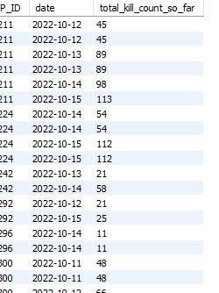
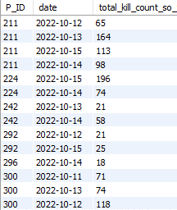
With or without output and many other line also

Slide 14
Find the cumulative sum of stages crossed over a start_datetime
SELECT P_ID, start_datetime, stages_crossed,
SUM(stages_crossed) OVER (PARTITION BY P_ID ORDER BY start_datetime) AS cumulative_stages_crossed
FROM level_details2;

Slide 15
Find the cumulative sum of an stages crossed over a start_datetime
WITH RankedLD AS (
SELECT P_ID, start_datetime, stages_crossed,
ROW_NUMBER() OVER (PARTITION BY P_ID ORDER BY start_datetime DESC) AS rn
FROM level_details2
)
SELECT P_ID, start_datetime, stages_crossed,
SUM(stages_crossed) OVER (PARTITION BY P_ID ORDER BY start_datetime) -
CASE WHEN rn = 1 THEN stages_crossed ELSE 0 END AS cumulative_stages_crossed
FROM RankedLD
WHERE rn <> 1;

Slide 16
Extract top 3 highest sum of score for each device id and the corresponding player_id
WITH RankedScores AS (
SELECT P_ID, Dev_ID, SUM(score) AS total_score,
ROW_NUMBER() OVER (PARTITION BY Dev_ID ORDER BY SUM(score) DESC) AS a
FROM level_details2
GROUP BY P_ID, Dev_ID
)
SELECT P_ID, Dev_ID, total_score
FROM RankedScores
WHERE a <= 3;

Slide 17
Find players who scored more than 50% of the avg score scored by sum of scores for each player_id
SELECT
P_ID, SUM(score) AS total_score
FROM
level_details2
GROUP BY P_ID
HAVING SUM(score) > (SELECT
0.5 * AVG(sum_score)
FROM
(SELECT
SUM(score) AS sum_score
FROM
level_details2
GROUP BY P_ID) AS avg_scores);

Slide 18
Create a stored procedure to find top n headshots_count based on each dev_id and Rank them in increasing order
DELIMITER //
CREATE PROCEDURE FindTopNHeadshots(
IN n INT
)
BEGIN
SELECT Dev_ID, headshots_count, difficulty, a
FROM (
SELECT Dev_ID, headshots_count, difficulty,
ROW_NUMBER() OVER (PARTITION BY Dev_ID ORDER BY headshots_count ASC) AS a
FROM level_details2
) AS ranked_headshots
WHERE a <= n;
END//
DELIMITER ;

Slide 19
Create a function to return sum of Score for a given player_id.
DELIMITER //
CREATE FUNCTION GetTotalScoreForPlayer(
player_id INT
)
RETURNS INT
BEGIN
DECLARE total_score INT;
SELECT SUM(score) INTO total_score
FROM level_details2
WHERE P_ID = player_id;
RETURN total_score;
END//
DELIMITER ;

Slide 20
Insights
1)Highest sum of stage crossed at any stages is by devId is zm_017
2)Total repeat player id is 211.
3)maximun kill count by player and level :
i)player 632 at level 0 has killed count is 45.
ii)player 663 at level 1 has killed count is 73.
iii)player 483 at level 2 has killed count is 94.
4) first login user is bd_013 at 2022-10-11 02:23:45

Slide 21
Thank You …
Any Queries??

